Slide 1
ASP.NET MVC
[Ravi Tambade]
[ravi.tambade@Transflower.in]
Notes:
Estimated Time: 60 minutes
This presentation serves as an introduction to ASP.NET MVC. It covers where it sits at within the ASP.NET ecosystem and what value propositions it offers. It includes demos showing how to create a basic ASP.NET MVC application as well as how to unit test it.

Slide 2
Session Objectives
What is ASP.NET MVC?
Is it deprecating WebForms?
What are its value propositions?
Notes:
Estimated Time: 1 minute
The main objectives of this session are to explain what ASP.NET MVC is and how it sits in the overall ASP.NET ecosystem. We’ll take a look at its main value propositions and see what style of development it enables.
The key takeaways are to determine whether or not ASP.NET MVC is the right choice for you as a developer, and to figure out whether or not it can ease some pain you’re currently experiencing as a web developer on the .NET stack.

Slide 3













ASP.NET Then…
ASP.NET
Caching
Modules
Globalization
Pages
Controls
Master Pages
Profile
Roles
Membership
Intrinsics
Handlers
Etc.
One web application
framework to rule them all…
Notes:
Estimated Time: 2 minutes
For the entire life of ASP.NET it has been seen as a single framework that included both runtime and presentational aspects. This includes core features such as roles and globalization, as well as WebForms features such as master pages and user controls.

Slide 4
WebForms is great, but options are good…
Notes:
Estimated Time: 1 minute
WebForms has been the only option on the ASP.NET stack and provides a mature product that has proven successful for lots of developers. But it does have some weaknesses.

Slide 5

Classic ASP.NET (Web Forms)
  High level abstraction over HTML / HTTP
  Simplified state management
  ViewState and the post‐back model
  Control model
  Data binding
  Simple event‐driven mechanism
  Simple Page Controller pattern

Slide 6
What makes it lazy …… web forms
  Sub‐optimal URLs
    blog.aspx?date=21032008
    Form runat="server"
  ViewState
  Hard to test
  All sorts of code in the page
  Requirement to test with an HttpContext

Slide 7
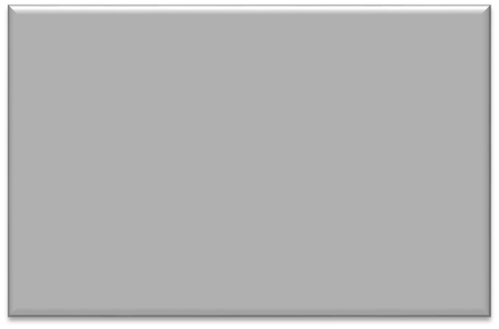


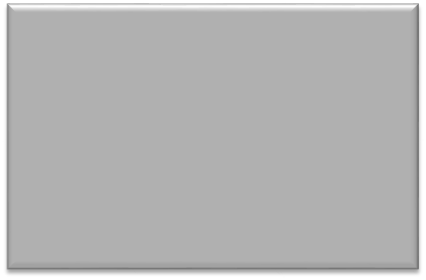


No real role responsibility…
Master Page
Control
Control
UI
Presentation Logic
Business Logic
Data Access
Control
Control
Page
Control
Control
Control
Control
Who does what?
How and when?
Notes:
Estimated Time: 2 minutes
The level of abstraction that WebForms provides has a lot of benefits to it, but it doesn’t provide any framework-level guidance in terms of what should do what and when. Between your pages, master pages, user controls, server controls, and custom controls, you can end up with a mixture of HTML, data access code, and business logic.
There are certainly methodologies/practices that can be employed with WebForms that can remedy that, but it becomes an implementation task of the developer, since the framework doesn’t provide any of that separation/guidance.

Slide 8
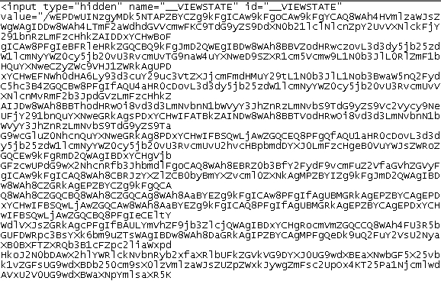
Control abstractions can be negative…
Notes:
Estimated Time: 2 minutes
The control abstractions that WebForms provides are very powerful in that they neatly contain all of the UI and business logic needed so you can just place them within a page and go. The adverse side of that is that it can end up hiding complexity that you’d rather have control over. A common problem is viewstate [Advance Animation]. It isn’t viewstate’s fault that things like this can happen, but it can be very easy to consume a control that could end up hurting the performance of your application.
In addition, many times the markup rendered by server controls aren’t always ideal and there is little control over that without having to redo its rendering completely.

Slide 9

It isn't easy enough to test…
Logic
UI
Notes:
Estimated Time: 1 minute
It is possible to test a WebForms application, but it isn’t easy enough. There isn’t enough prescriptive guidance around how to do it properly, and for many it requires more effort than it is worth. For unit testing to truly become mainstream and approachable, testability has to be a prime concern of the framework being used, such that writing tests against applications written with it is easy.

Slide 10
So how does ASP.NET MVC differ?
Notes:
Estimated Time: 1 minute
What is it about ASP.NET MVC that differentiates itself from WebForms? What value propositions does it provide and how does it benefit users? The primary thing is that it embraces the MVC pattern at the architectural level, and is generally just about getting out of the way of the developer, allowing you to have full control over the areas you want/need to.

Slide 11
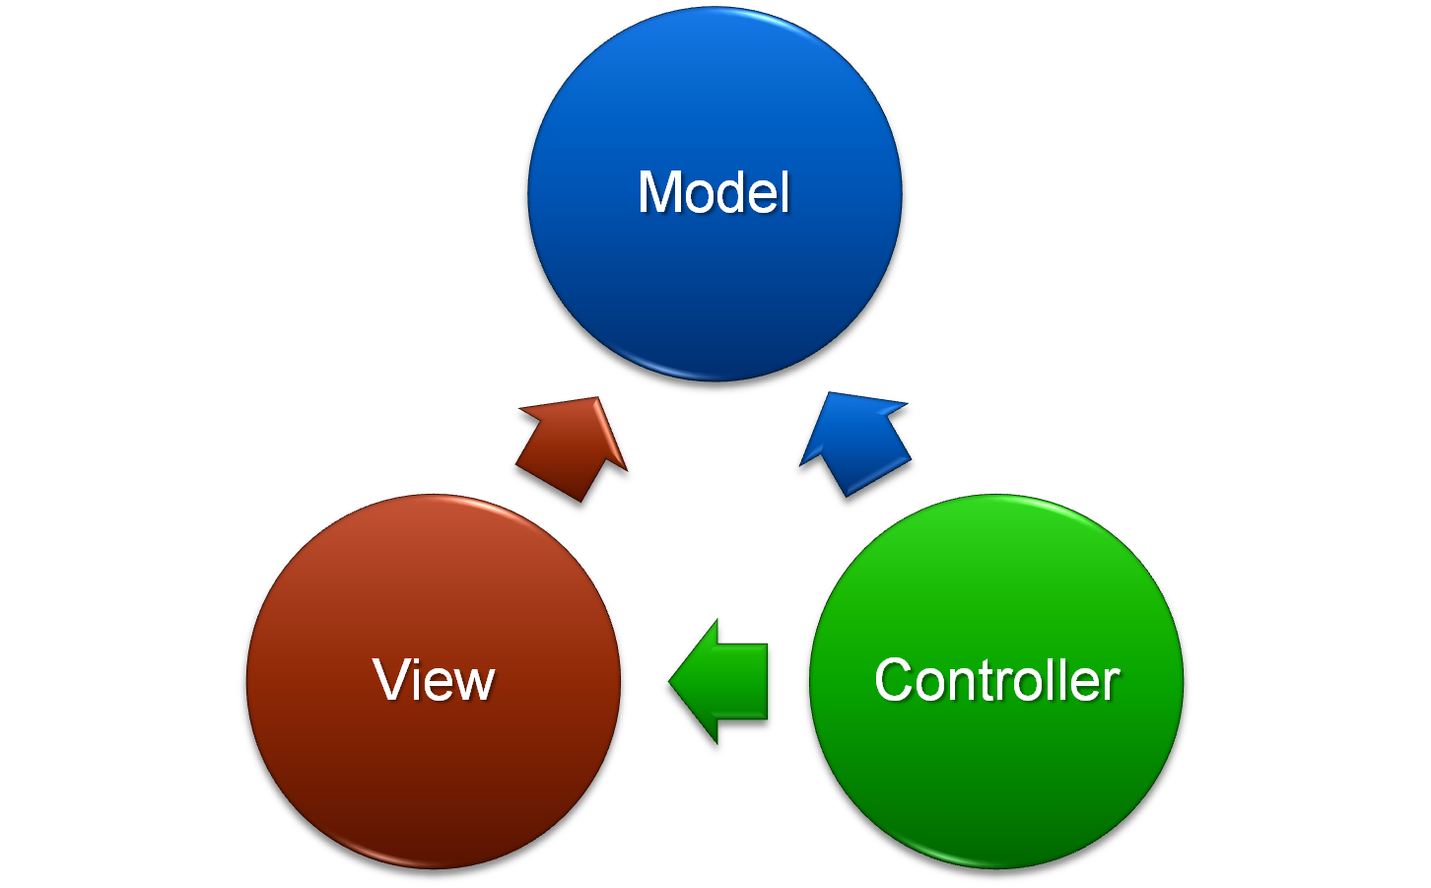
ASP.NET MVC
Separation of concerns!

Slide 12








How does MVC look?
Controller
Controller
Handles input
(HTTP requests)
Request
View
View
Visually represents
the model
Response
Notes:
MGB 2003
© 2003 Microsoft Corporation. All rights reserved.
This presentation is for informational purposes only. Microsoft makes no warranties, express or implied, in this summary.
Estimated Time: 4 minutes
So what does MVC look like when implemented over the web?
When an HTTP request comes into the application it is mapped to a controller. Remember as we mentioned in the previous slide, in the MVC design pattern, the controller is the piece of the trifecta that handles all user input. In the case of a web application, user input is represented as HTTP requests [Advance Animation].
Once the controller has received input, it performs whatever operations it needs to and then assembles a presentation model [Advance Animation].
The controller then takes the model and passes it off to the view. Remember that the view is simply a visual representation of the model [Advance Animation].
The view then “transforms” the model into whatever format it uses to represent it. In a web application, this would typically be HTML [Advance Animation].
The view then serves the request by responding with its visual representation.

Slide 13
ASP.NET MVC Tenets
Alternative
Testable
Extensible
Routable
Notes:
Estimated Time: 2 minutes
Talking Points:
The main tenets of ASP.NET MVC are…
Alternative
ASP.NET MVC builds on top of ASP.NET, it doesn’t replace it. It is simply meant to serve as an alternative approach to developing web applications using ASP.NET.
Testable
While WebForms can be tested, it isn’t the most trivial task. ASP.NET MVC was built with testing in minding, so practicing TDD, or just simply writing unit tests, is a simple task with MVC.
Extensible
MVC follows the convention over configuration principle. At the same time, it isn’t meant to constrain developers by its conventions. MVC is built on an extensible framework that virtually every component can be easily replaced with your own logic.
Routable
ASP.NET MVC uses ASP.NET Routing to associate URL patterns with controller actions. This means that your MVC applications will naturally be search-engine optimized, since every controller action that corresponds to an HTTP GET can get be easily discovered.

Slide 14
ASP.NET MVC doesn’t have…
Postbacks
View state
Control state
Server-side form
Page/Control lifecycle
Notes:
Estimated Time: 2 minutes
Talking Points:
Now’s let’s briefly discuss the differences between WebForms and ASP.NET MVC.
While MVC is built on top of ASP.NET, it doesn’t have…
Postbacks
View state or control state
Server-side form
Page/control lifecycle
The page/control lifecycle is still present if you’re using WebForms as your view engine, but even then, you most likely won’t be using it.

Slide 15
ASP.NET MVC still has…
Web designer
Master pages & User controls
Membership/Roles/Profile
Globalization & Caching
HTTP intrinsics:
  HttpContext
  HttpRequest
  HttpResponse
  Etc.
Notes:
Estimated Time: 2 minutes
Talking Points:
Just to reiterate the point that MVC is built on top of ASP.NET, let’s briefly discuss the similarities…
Web designer
Master pages
User controls
Membership/Roles/Profile providers
Globalization
Caching
The HTTP intrisincs

Slide 16
Routing
  Routing provides "clean" URLs
  URL is mapped to a route handler
  Extra level of indirection
  Handlers can be changed without impacting URL
  URL can be changed without impacting handler
  Enables support for multilingual URLs
  URL Example : http://www.mysite.com/Home/ProductList

Slide 17

Routing
  Developers adds Routes to a global RouteTable
  Mapping creates a RouteData - a bag of key/values
public static void RegisterRoutes(RouteCollection routes)
{
routes.IgnoreRoute("{resource}.axd/{*pathInfo}");
routes.MapRoute( "Default", // Route name "{controller}/{action}/{id}", // URL with parameters
new {
controller = "Home", // Parameter defaults
action = "Index",
id = ""
}
);
}
protected void Application_Start()
{
RegisterRoutes(RouteTable.Routes);
}

Slide 18
MVC Controllers
Scenarios, Goals and Design
  URLs route to controller “actions”,
    not pages – mark actions in Controller.
  Controller executes logic, chooses view.
  All public methods are accessible
public void ShowPost(int id) {
Post p = PostRepository.GetPostById(id);
if (p != null) {
RenderView("showpost", p);
} else {
RenderView("nosuchpost", id);
}
}

Slide 19
Controller Conventions
Controller
  Must…
    Be suffixed with “Controller”
    Implement IController (or inherit from Controller)
Action
  Must…
    Be Public
    Return ActionResult or void
  Can’t…
    Be generic
    Have a NonActionAttribute
    Have out/ref parameters
Notes:
Estimated Time: 2 minutes
Talking Points:
There are a lot of conventions centered around your controllers that are important to be aware of.
When you create a controller, the class name must be prefixed with “Controller”, hence a controller for customers could be named “CustomerController”. Everywhere you refer to controllers you do so with the “Controller” portion, because the framework knows to append it on for you. This behavior is similar to attributes.
A controller must ultimately implement the IController interface. ASP.NET MVC provides the Controller class which implements IController and provides a lot of beneficial behavior. Most times you’ll create your controllers by inheriting from Controller, but if you need complete control you could implement IController.
When you create an action method within your controller, it has to be a public method that returns an ActionResult (or a derivative).
The action method can’t be generic, can’t have any out/ref parameters, and can’t be salted with a NonActionAttribute.

Slide 20
Views
Scenarios, Goals and Design:
  Are for rendering/output.
    Pre-defined and extensible rendering helpers
  Can use .ASPX, .ASCX, .MASTER, etc.
  Can replace with other view technologies:
    Template engines (NVelocity, Brail, …).
    Output formats (images, RSS, JSON, …).
    Mock out for testing.
  Controller sets data on the View
    Loosely typed or strongly typed data

Slide 21
Clean URLs
Don’t settle for…
/Products.aspx?CategoryID=123
When you can easily have…
/Product/Puppies
Or whatever else makes sense…
Notes:
MGB 2003
© 2003 Microsoft Corporation. All rights reserved.
This presentation is for informational purposes only. Microsoft makes no warranties, express or implied, in this summary.
Estimated Time: 2 minutes
Since ASP.NET MVC is so tightly integrated with the ASP.NET Routing engine, it is simple to take control over the URLs that your application exposes. As such, you shouldn’t have to settle for poor URLs that are simply based on the organization of your application’s internals. You should design your sitemap to be as intuitive as you want.
When you do this, users will be happier, and so will search engines.

Slide 22
ASP.Net MVC 3
Quick look into Visual Studio 2010 SP1
ASP.NET 4 Web Forms
MVC 3 with Razor
Using Web Forms and MVC together
Scenarios for usage
Notes:
End to end.. Using vs2010, how to deploy the app, publishing out to the wild
Very exciting release… the work we have done here addresses the real things that customers have been asking us

Slide 23

Easier to start, develop & deploy
Routing and Search Engine Optimization
Better Client Handling capabilities
Productivity and extensibility
Notes:
- E-2-E scenarios with Visual Studio 2010
Simplified config and new proj. templates
- Cleaner = better SEO
Simple support for <meta>
URL routing
- Generate (standards) HTML and use CSS
Control markup, styles, routing & page size
- Dynamic data & support for existing apps
Charts
Runtime extensibility

Slide 24

Clear separation of concerns
Friendlier URLs
Cleaner HTML
Patterns & Repositories
Notes:
- E-2-E scenarios with Visual Studio 2010
Simplified config and new proj. templates
- Cleaner = better SEO
Simple support for <meta>
URL routing
- Generate (standards) HTML and use CSS
Control markup, styles, routing & page size
- Dynamic data & support for existing apps
Charts
Runtime extensibility

Slide 25

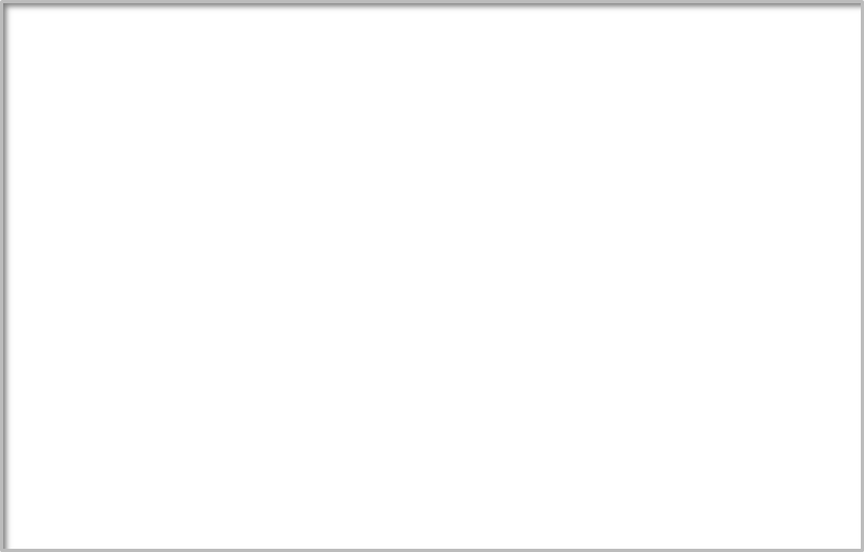






Visual Studio
.NET 4
Web Forms
MVC
Authentication
Membership
Data Providers
ASP.NET

Slide 26

Ease of adoption in existing projects
Pages where finer markup control is needed
Best of both worlds
No from the scratch work
Notes:
- E-2-E scenarios with Visual Studio 2010
Simplified config and new proj. templates
- Cleaner = better SEO
Simple support for <meta>
URL routing
- Generate (standards) HTML and use CSS
Control markup, styles, routing & page size
- Dynamic data & support for existing apps
Charts
Runtime extensibility

Slide 27

Familiarity with Client Development
Lots of abstraction, automation
Mark up, Scripts, Browser differences handled
SharePoint runs on Web Forms
Notes:
- E-2-E scenarios with Visual Studio 2010
Simplified config and new proj. templates
- Cleaner = better SEO
Simple support for <meta>
URL routing
- Generate (standards) HTML and use CSS
Control markup, styles, routing & page size
- Dynamic data & support for existing apps
Charts
Runtime extensibility

Slide 28

Familiar for Web Developers
Finer control over mark up
Designed for friendly URLs
Designed for patterns/respositories
Notes:
- E-2-E scenarios with Visual Studio 2010
Simplified config and new proj. templates
- Cleaner = better SEO
Simple support for <meta>
URL routing
- Generate (standards) HTML and use CSS
Control markup, styles, routing & page size
- Dynamic data & support for existing apps
Charts
Runtime extensibility

Slide 29
ASP.NET MVC
Razor View Engine
Multiple View Engine Support
Validation Improvements
Dynamic ViewBag
Global Filters
New ActionResults
Project Dialog Improvements
VBHTML Support
Task-based Helpers
Improved Dependency Injection
Porting MVC Script Libraries to jQuery
Granular ValidateInput
Add View Dialog Improvements
Project Dialog Extensibility Improvements
Improved Caching Support
JSON Binding Support

Slide 30
What’s new in ASP.NET MVC
Razor View Engine
Multiple View Engine Support
Validation Improvements
Dynamic ViewBag
Global Filters
New ActionResults
Project Dialog Improvements
VBHTML Support
Task-based Helpers
Improved Dependency Injection
Porting MVC Script Libraries to jQuery
Granular ValidateInput
Add View Dialog Improvements
Project Dialog Extensibility Improvements
Improved Caching Support
JSON Binding Support

Slide 31
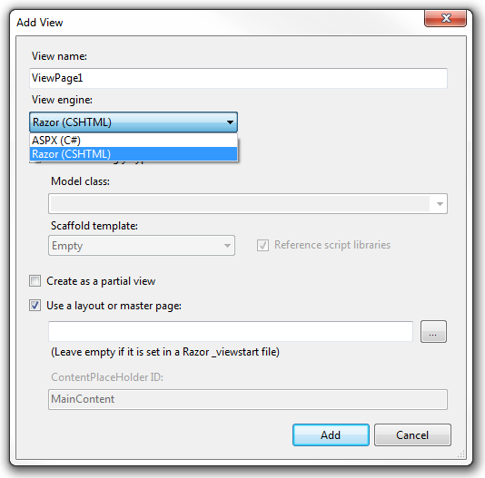
Multiple View Engine Support
protected void Application_Start()
{
ViewEngines.Engines.Add(new SparkViewFactory());
…
}
Notes:
I have a demo for adding new views to this dialog.

Slide 32
Razor
The Razor View Engine
  Razor syntax is clean and concise, requiring a minimum number of keystrokes.
  Razor is easy to learn, in part because it's based on existing languages like C# and Visual Basic.
  Visual Studio includes IntelliSense and code colorization for Razor syntax.
  Razor views can be unit tested without requiring that you run the application or launch a web server.

Slide 33
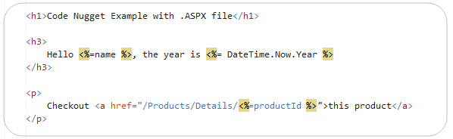
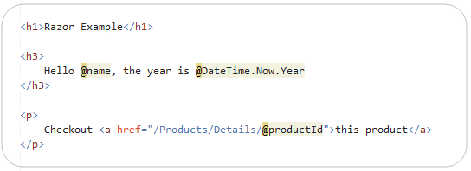
Syntax Comparison
Using traditional asp.net code
Using Razor

Slide 34
Filters
Filters are custom classes that provide both a declarative and programmatic means to add pre-action and post-action behavior to controller action methods
  Authorization filters
  Action filters
  Result filters
  Exception filters
Notes:
Sometimes you want to perform logic either before an action method is called or after an action method runs. To support this, ASP.NET MVC provides action filters. Action filters are custom attributes that provide a declarative means to add pre-action and post-action behavior to controller action methods. Some action filters are provided by the framework, such as IAuthorizationFilter, but you can also write your own filters.
In prior versions of MVC, the only way to apply filters was to make a filter attribute and apply that attribute to a controller or an action method. In MVC 3, you can have filters which are defined outside the scope of attributes (and found via filter providers), as well as a facility for registering global filters.
Filter providers are a new feature to MVC 3. They are a "multiply registered" style service, with a static registration point at FilterProviders.Providers. This collection provides a facade method (GetFilters) which aggregates the filters from all of the providers into a single list. The order of the providers is not important.

Slide 35
Dynamic ViewBag
  MVC 2 controllers support a ViewData property that enables you to pass data to a view template using a late-bound dictionary API.
  In MVC 3, you can also use somewhat simpler syntax with the ViewBag property to accomplish the same purpose.
  For example, instead of writing ViewData["Message"]="text", you can write ViewBag.Message="text".
  You do not need to define any strongly-typed classes to use the ViewBagproperty.
  Dynamic property, you can instead just get or set properties and it will resolve them dynamically at run time.
<head>
<title>@ViewBag.Title<title>
</head>

Slide 36
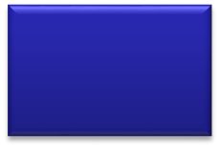
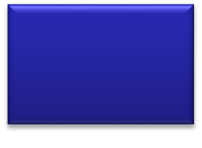

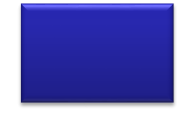


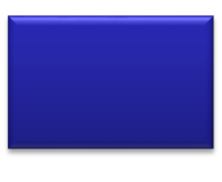





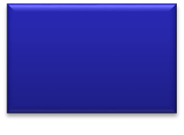
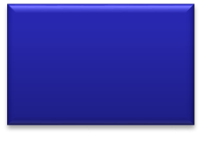



Extensibility
Action
Filters
Model
Binders
Controller
Builder
Controller
Factory
Controller
Controller
Action
Invoker
View
View
Engine
Action
Result
Any of this can be replaced!
Notes:
MGB 2003
© 2003 Microsoft Corporation. All rights reserved.
This presentation is for informational purposes only. Microsoft makes no warranties, express or implied, in this summary.
Estimated Time: 2 minutes
While ASP.NET MVC provides a strong offering of functionality out of the box, there will be developers that don’t like some of its default behavior or conventions. Luckily for them they can easily replace anything in the execution pipeline they don’t care for with their own implementation.
Because ASP.NET MVC employs separations of concerns throughout its entire API, every task has specific representation that can easily be tweaked/replaced, without having to affect anything else around it.

Slide 37
Dependency Injection Improvements
ASP.NET MVC 3 provides better support for applying Dependency Injection (DI) and for integrating with Dependency Injection or Inversion of Control (IOC) containers. Support for DI has been added in the following areas:
  Controllers (registering and injecting controller factories, injecting controllers).
  Views (registering and injecting view engines, injecting dependencies into view pages).
  Action filters (locating and injecting filters).
  Model binders (registering and injecting).
  Model validation providers (registering and injecting).
  Model metadata providers (registering and injecting).
  Value providers (registering and injecting).

Slide 38
Model Binding
Model binding is the process of creating .NET objects using the data sent by the browser in an HTTP request.
Default model binder search in following location and order for named parameters data.
Source | Description
Request.Form | Contents HTML form elements data.
RouteData.Values | Application routes values
Request.QueryString | Data in the query string of the request URL
Request.Files | Files that have been uploaded as part of the request.

Slide 39
Model Binding
Bind attribute: To include or exclude model properties from the binding process.
  To include first and last name in person object. Person FirstName and LastName property value will be consider other will ignored.
public ActionResult Register([Bind(Include = "FirstName, LastName")]
Person person)
  Example: To exclude sex property in person object.
    Person sex property value will be ignored.
public ActionResult Register([Bind(Exclude = "Sex")] Person person)

Slide 40
Summary
ASP.NET MVC is a new application option built on top of ASP.NET
WebForms isn’t being deprecated
ASP.NET MVC strives to provide strong, frictionless testability
It places a lot of the control in your hands
Notes:
Estimated Time: 1 minute
In summary, ASP.NET MVC is simply a new web application type that is built on top of the ASP.NET runtime. It is not replacing WebForms but is simply a new option. It you care a lot about testability and control then ASP.NET MVC is most likely for you.

